Slide 1
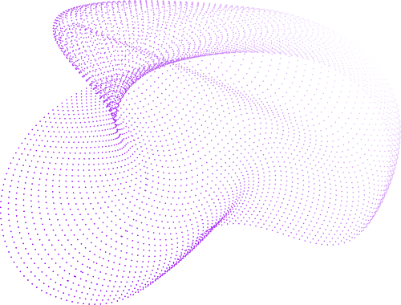

KHARAGPUR DATA-ANALYTICS HACKATHON
ZELTA PROBLEM STATEMENT

Slide 2

01
ZELTA PROBLEM STATEMENT
Algorithmic Trading Model for BTC/USDT Crypto Market, employing advanced quantitative techniques for optimized strategies and increased profitability. Addressing volatility challenges, the model prioritizes risk management and adaptability, redefining crypto trading through innovation.

Slide 3

EXPECTATIONS:
Increased Profitability: By leveraging data-driven insights and predictive analytics, our model aims to enhance trading performance, leading to increased profitability in the BTC/USDT market.
Reduced Human Error: Automation minimizes the impact of emotional decision-making, a common pitfall in trading. The algorithm executes predefined strategies without succumbing to fear or greed.

Slide 4

CONTINUOUS IMPROVEMENT: REGULAR UPDATES AND REFINEMENTS ENSURE THAT OUR ALGORITHM REMAINS AT THE FOREFRONT OF TECHNOLOGICAL ADVANCEMENTS, ADAPTING TO EMERGING MARKET TRENDS.
Anticipated outcomes: It include improved trading performance, minimized human error, and continuous model refinement, ensuring it remains at the forefront of evolving market dynamics.
OVERALL TAKEAWAY:
The Algorithmic Trading Model is anticipated to yield improved trading performance, mitigating losses through dynamic risk management. Continuous optimization ensures alignment with market trends, fostering a resilient and profitable approach in the ever-changing landscape of BTC/USDT cryptocurrency trading.

Slide 5
Data Acquisition: from
January 1, 2018, to January 31, 2022
MODEL DESIGN
Model includes a mean revolution, machine learning and quantitative/statistical approaches.
We used indicators like simple moving average with back trader as its back-testing model.
We also used SMA cross strategy as indicator.

Slide 6

02
CODE EXPLANATION
The specified time frame has a fast SMA period set to 35 and a slow SMA period set to 300.
fast_sma_period and slow_sma_period: Define the periods for the fast and slow Simple Moving Averages (SMA).
timeframe: A parameter for specifying the timeframe (not used in the strategy logic).
Utilized the backtrader library to conduct back-testing on the current SMA model and gathered all the necessary data from the backtrader model.

Slide 7

Implemented a strategy based on the crossing of Simple Moving Averages (SMA).
Utilized a Fast SMA and Slow SMA strategy with periods set at 50 and 200 for the given time frame.
Specified attributes comprise open, high, close, low, volume, name, and time frame for comprehensive analysis.
Checking for crossover
If any crossover is close to the ‘close’ price, then
price=data.close[0]
Checking for cross under

Slide 8
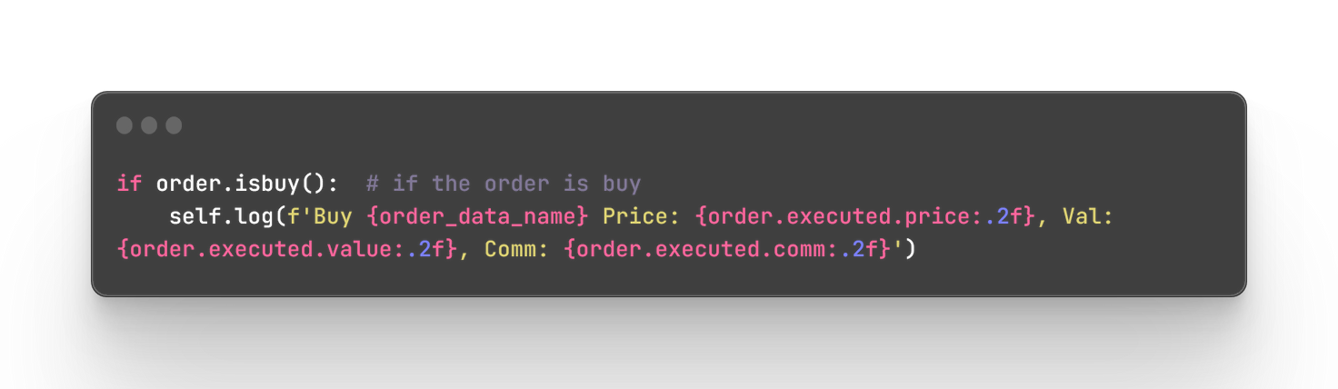
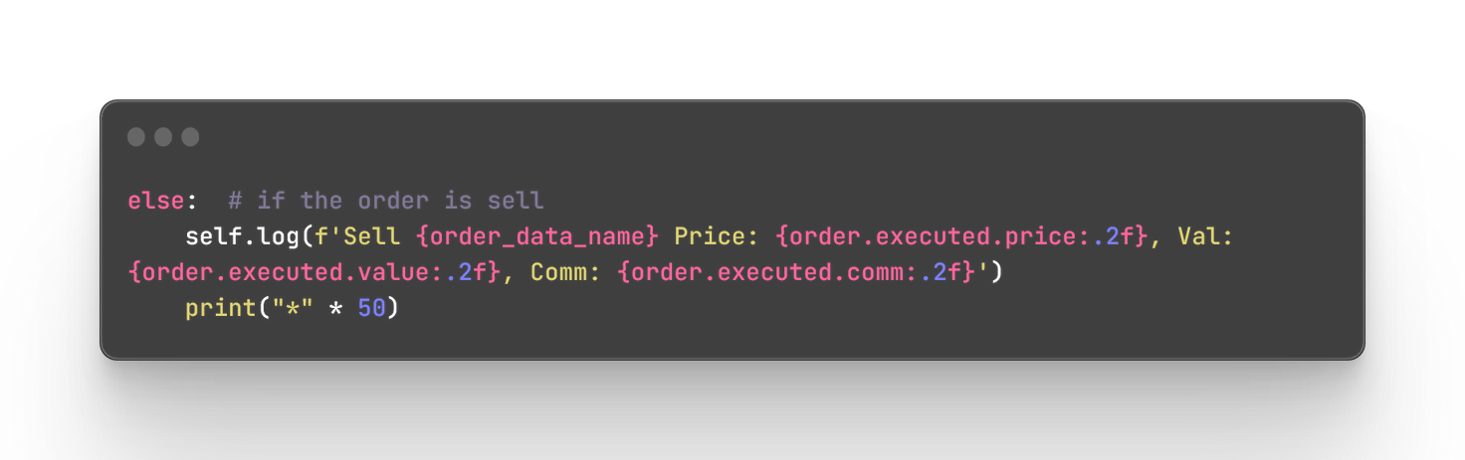

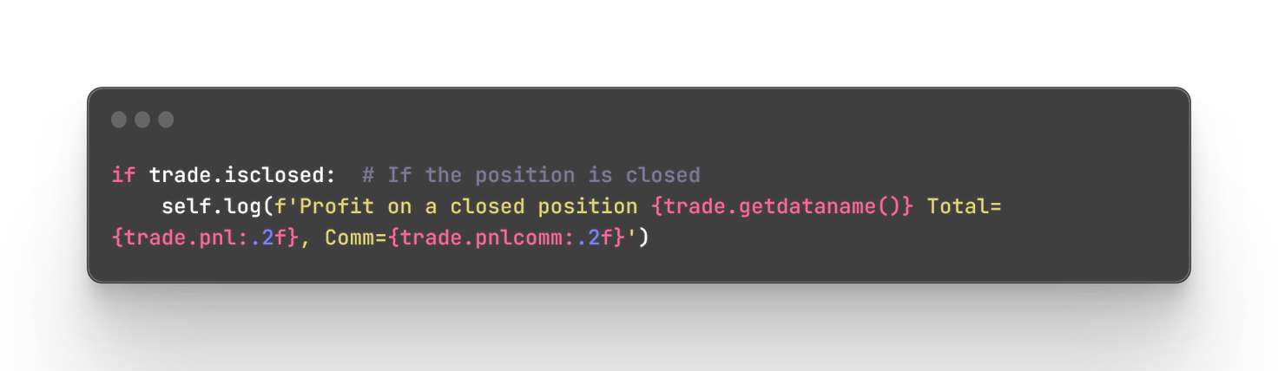
Changing the state of the order
Checking whether the order is confirmed and executed
If the order is buy:
If the order is sell:
If the position is closed:

Slide 9


BACKTESTING USING CEREBRO
1. cerebro = bt.Cerebro():
- Creates a Cerebro engine, which is the core of the backtesting framework in backtrader.
2. cerebro.broker.set_cash(100000):
- Sets the initial cash amount in the broker account to $100,000.
3. cerebro.broker.setcommission(commission=0.0015):
- Configures the broker commission for buying or selling assets.
- In this case, the commission is set to 0.15% (0.0015) of the transaction value.

Slide 10
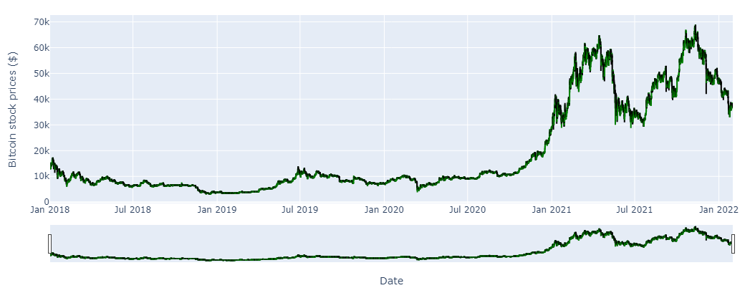
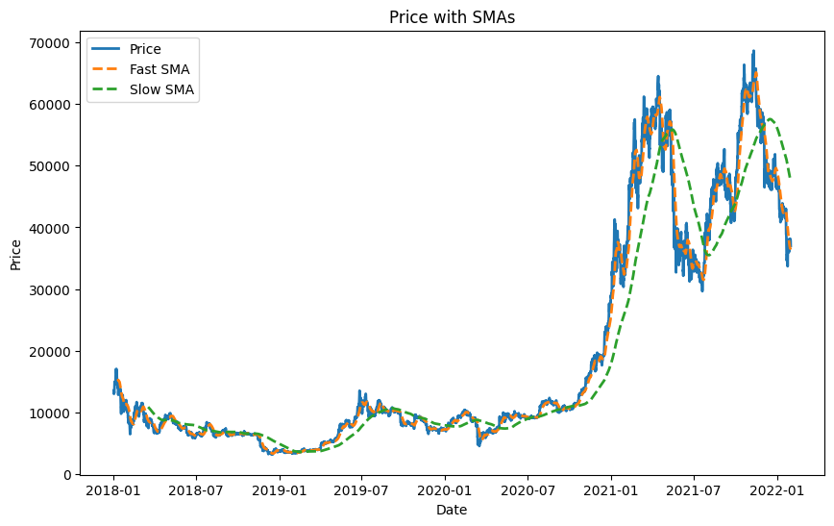
Graph 01: Prediction Graph
Graph 02: SMA Backtested Cross Strategy

Slide 11
BACKTESTING USING CEREBRO
4. data = bt.feeds.PandasData(dataname=df, name=ticker):
- Creates a PandasData object, which is a backtrader data feed specifically designed to handle Pandas DataFrames.
- dataname=df: Specifies the Pandas DataFrame containing historical price data (df).
- name=ticker: Assigns a name to the data feed, typically representing the ticker symbol of the asset.
5. cerebro.adddata(data):
- Adds the created data feed (data) to the cerebro backtesting engine.
- Multiple data feeds can be added if you want to test a strategy on multiple assets simultaneously.

Slide 12
BACKTESTING USING CEREBRO
6. cerebro.addstrategy(SMACrossStrategy, timeframe=timeframe, fast_sma_period=fast_sma_period, slow_sma_period=slow_sma_period):
- cerebro.addstrategy: Adds a strategy to the backtesting engine.
- SMACrossStrategy: The strategy class being added to the engine. This is the custom strategy defined in your code.
7. timeframe, fast_sma_period, slow_sma_period:
- During instantiation of the SMACrossStrategy, additional parameters are provided to customize the strategy's behavior, including the timeframe of data and the periods for the fast and slow Simple Moving Averages (SMAs).

Slide 13
BACKTESTING USING CEREBRO
8. cerebro.broker.getvalue():
- This retrieves the current value of the portfolio in the backtesting environment.
9. print(f"Starting Portfolio Value: {cerebro.broker.getvalue():.2f}"):
- It then prints the starting portfolio value to the console using an f-string.
- “.2f” is used to format the value with two decimal places.

Slide 14

RESULTS OF ROI/DRAWDOWNS/SHARPE RATIO
Initial Investment = 100000
Ending Portfolio Value = 152542.54
Remaining Available Funds = 152542.54
Max Drawdowns = 9.9312
Sharpe Ratio = 1:2
ROI/ DRAWDOWNS/ SHARPE RATIO FROM BACKTESTING RESULTS

Slide 15

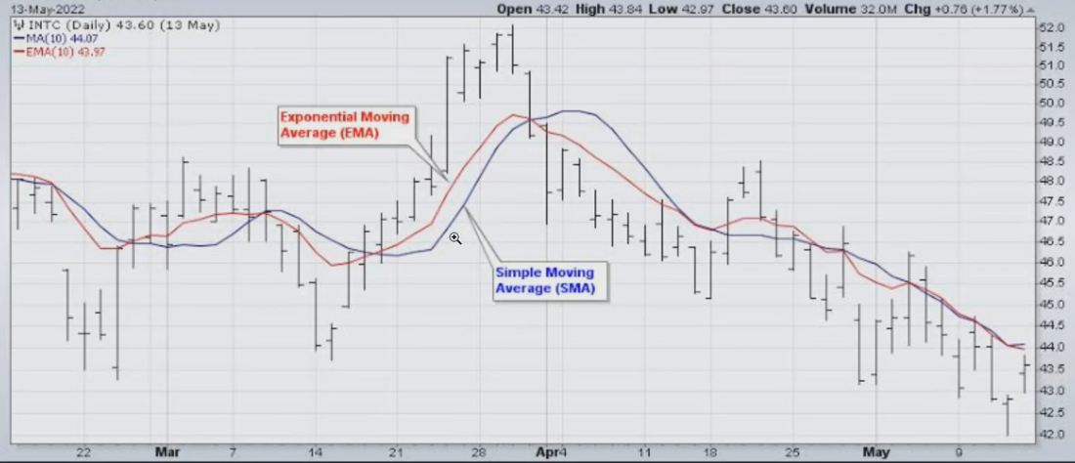
JUSTIFICATION FOR USING DATA MODEL/ INDICATOR

Slide 16

1. Trend Identification:
- SMAs are commonly used to identify trends in financial markets. The strategy in the code leverages the relationship between a shorter-term SMA (fast) and a longer-term SMA (slow) to identify potential trends in the price movement.
2. Crossover Signals:
- The strategy generates buy signals when the fast SMA crosses above the slow SMA. This is often interpreted as a bullish signal, indicating a potential upward trend.
3. Crossunder Signals:
- Conversely, sell signals are generated when the fast SMA crosses below the slow SMA, signaling a potential reversal or the beginning of a downward trend.

Slide 17
4. Backtesting:
- The code is designed for backtesting, allowing the evaluation of the SMA-based strategy's historical performance on price data. This is essential for assessing its viability before deploying it in a live trading environment.
5. Customization:
- The code provides parameters for adjusting the periods of the fast and slow SMAs, allowing users to customize the strategy based on their preferences or market conditions.

Slide 18
Reference
The Team
https://chat.openai.com
https://in.tradingview.com
https://www.binance.com
Aditya Sunil Nadiger
Rishabh Laxmikanth
Shourya S
Hamshini S Shetty
https://www.backtrader.com

Slide 19

THANK YOU

